Slide 1

SENTIMENTAL ANALYSIS ON restaurant reviews
PROJECT BY
KAJA LAKSHMI SAI PRIYA-1001843857
PULAGAM MOHAN VIKAS REDDY-1001916601
ADITYA DHEERAJ GUNDA-1001960773

Slide 2
What is sentimental analysis?
Sentimental Analysis also referred as Opinion Mining, is a Natural Language Processing Technique which identified the emotion/sentiment behind the text.
Sentimental Analysis analyses a bunch of text to determine if it is positive, negative or neutral.
Sentiment analysis tools extracts opinions which helps to understand what users think and react to improve the user experience.

Slide 3
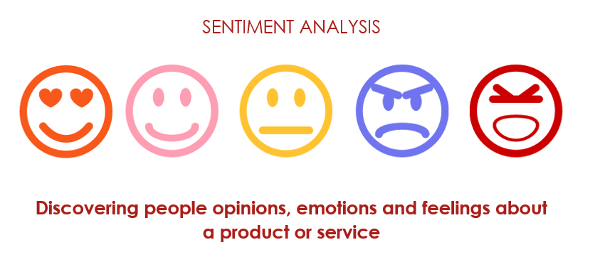

Slide 4
APPLICATIONS OF SENTIMENTAL ANALYSIS FOR RESTAURANT REVIEWS
We might be unaware of how the food is in restaurant like, opinion mining helps users to classify the number of positive and negative reviews given by the customers. Graphical representations or number of reviews received for each classifier helps to determine the rating of the restaurant.

Slide 5
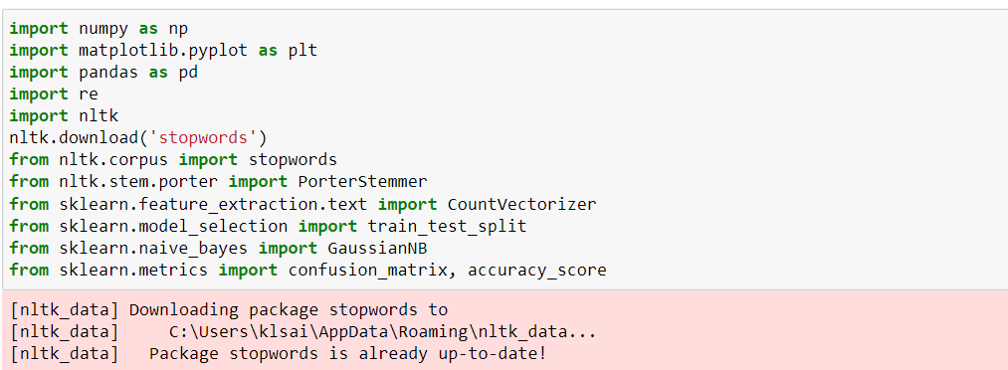
GETTING STARTED WITH SENTIMENTAL ANALYSIS
STEP 1:
Including the Required Libraries:

Slide 6
STEP 2:
Importing the Dataset
STEP 3:
Check if there is any null data available in the given dataset. And the next-step is to pre-process the data

Slide 7
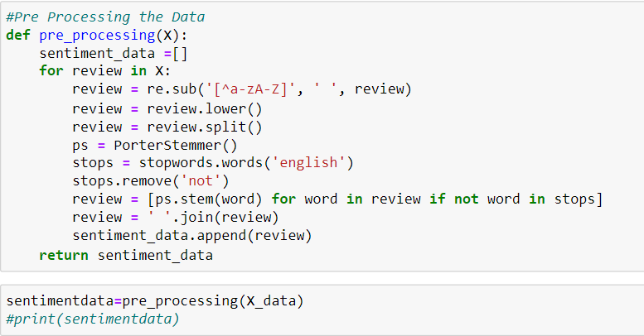
STEP 4: PREPROCESSING THE DATA

Slide 8
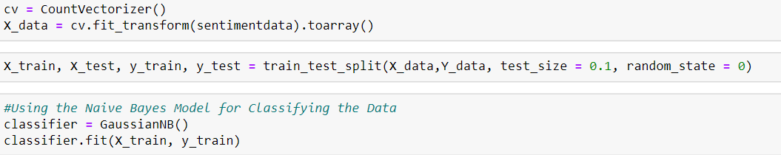
STEP 5: APPLYING NAIVE BAYES ALGORITHM FOR CLASSIFYING THE DATA

Slide 9
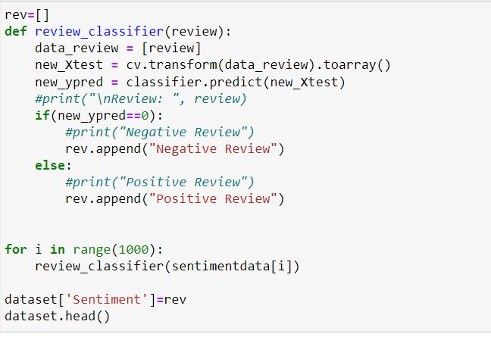
STEP 6: CLASSIFYING SENTIMENTS TO THE REVIEW DATA

Slide 10
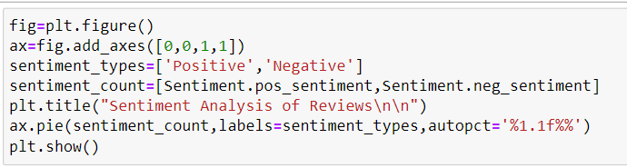
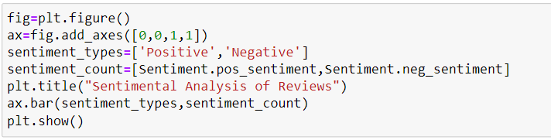
STEP 7: VISUALISING THE REVIEWS

Slide 11
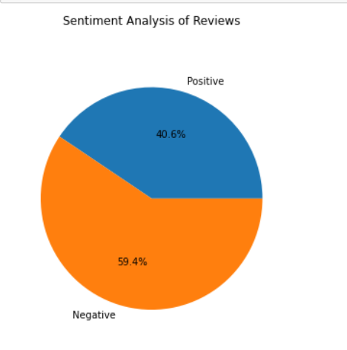
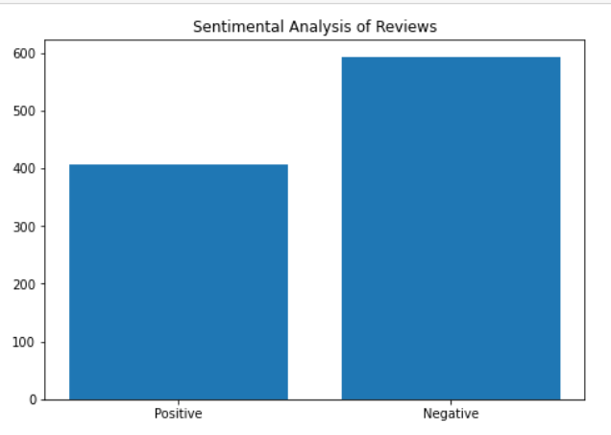

Slide 12
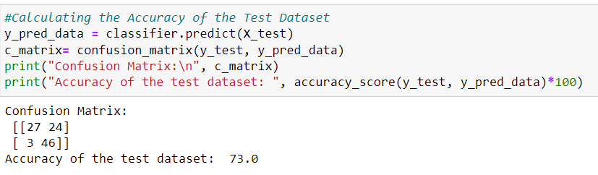
STEP 8: FINDING ACCURACY OF THE TEST DATASET

Slide 13
CONCLUSION
This type of Sentimental Analysis will help to extract opinions and classify sentiments to the reviews that will help to understand the reviews of a restaurant.
Although multiple methods can be used for classification, the reason behind choosing Naïve Bayes Classifier inspite of less accuracy is that it showed better performance with the examples we have tried compared to others.

Slide 14


